Slide 1
Histogram Equalization
Computational thinking

Slide 2
Histogram Equalization Problem
Enhance the contrast of an image using histogram equalization
Why?
Images in foggy or poorly lit environments look dull or low-contrast
Histogram equalization stretches pixel intensities
Makes details more visible

Slide 3
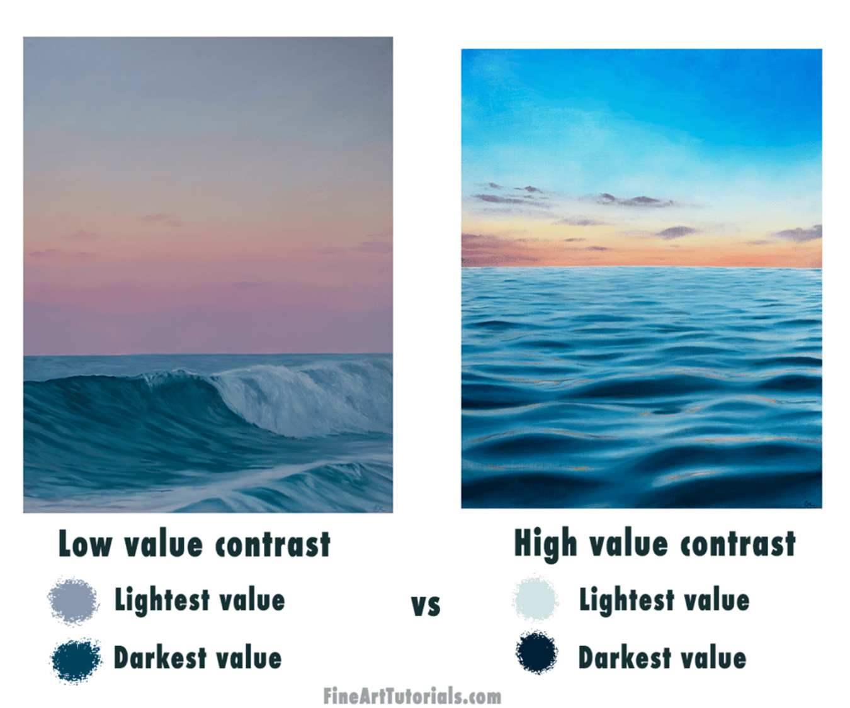
Low vs High contrast

Slide 4
Problem analysis
ill-defined: Make this image clearer
Well-defined:
Input: a grayscale image
Output: enhanced grayscale image
Goal: redistribute intensities to span 0–255 more evenly

Slide 5
Decomposition
1. Read grayscale image
2. Compute histogram
3. Normalize histogram
4. Compute cumulative distribution function (CDF)
5. Map old pixel values to new ones
6. Generate and display equalized image

Slide 6
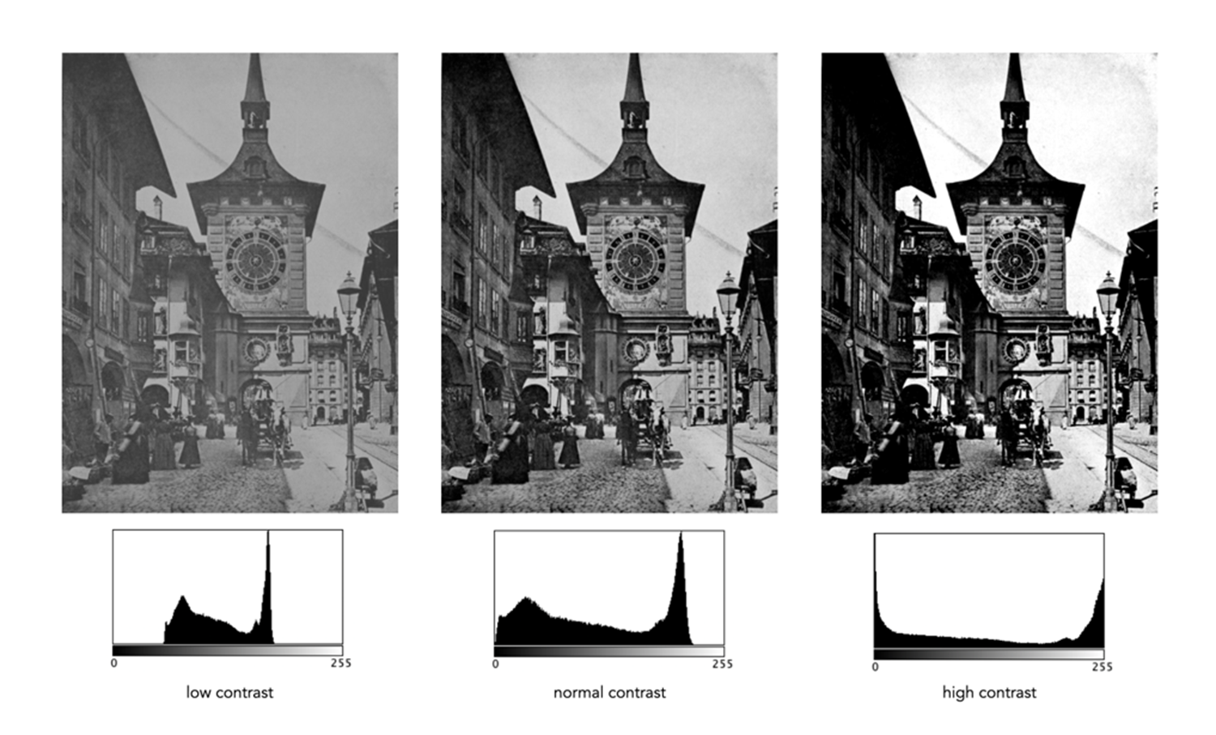
Pattern recognition
Low-contrast images → peaked histograms
Good contrast → spread-out histograms
CDF stretches histogram into balanced form

Slide 7
Abstraction
Image: 2D array of integers (0–255)
Histogram: 1D array of pixel frequencies
CDF: remap pixel values

Slide 8
Algorithm design
function histogram_equalization(image):
hist = compute_histogram(image)
cdf = compute_cumulative(hist)
cdf_normalized = scale_cdf(cdf, 0–255)
new_image = map_pixels(image, cdf_normalized)
return new_image
Formula:
new_pixel = floor((CDF[pixel] - CDF_min) / (N - CDF_min) × 255)

Slide 9
Simulation / Implementation
Python + OpenCV example:
import cv2
img = cv2.imread('image.jpg', 0) # grayscale
equalized = cv2.equalizeHist(img)
cv2.imshow('Equalized', equalized)

Slide 10
Testing / Improvement
Test on low-contrast images
Evaluate: visibility of details, histogram flatness
Improve: histogram equalization, generative models

Slide 11
Conclusion
Histogram Equalization is a powerful CT example
Involves data collection, transformation, mapping
Simple computation greatly improves perception

Slide 12
Applications in
Smart travel system

Slide 13
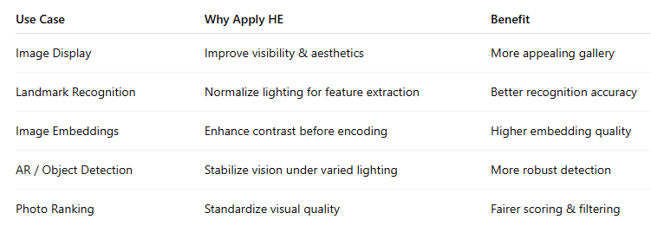
Summary

Slide 14
01. Enhance Travel Photos for Display
Apply HE to user-uploaded or system images before showing them in the app.
Improves clarity and aesthetics of low-light or overexposed travel images.
Example:
A tourist uploads a dark photo of a night market.
HE improves brightness and contrast → photo looks clearer and more attractive in their travel diary or recommendation feed.

Slide 15
02. Improve Image-Based Landmark Recognition
If your Smart Travel System includes automatic place recognition (e.g., detecting Eiffel Tower or Ha Long Bay from photos):
Apply Adaptive Histogram Equalization (CLAHE) before feature extraction (e.g., SIFT, ORB, CNN).
Increases feature detectability under varied lighting conditions.
Result: More consistent feature matching between images taken at different times of day or weather conditions

Slide 16
03. Enhance Visual Data for Recommendation Models
When using image embeddings (e.g., CLIP, ResNet features) for destination or hotel recommendation:
Preprocess images with histogram equalization
→ produces consistent input lighting/contrast
→ better embedding quality
→ more reliable similarity scores

Slide 17
04. Improve Scene Understanding in Smart Cameras or AR
If your travel system integrates AR navigation or smart camera recognition: Use HE to normalize lighting before object detection or segmentation.
Example: Detecting road signs or scenic viewpoints under sunlight glare or fog.

Slide 18
05. Quality Scoring or Filtering
If your app filters “best-looking” photos to display in a travel feed:
HE can help standardize image brightness
→ easier to compute perceptual quality metrics (like sharpness, contrast, or aesthetic scores).

